Slide 1

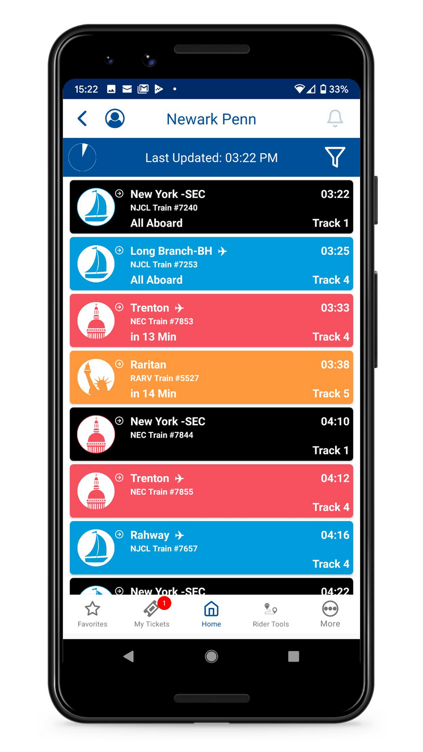

By J^2
Ridr
A predictive dashboard application for transit agencies
Our goal: To create a tool for companies to identify where trains will be late, to reduce lateness in public transit systems.
Notes:
Use Case: predict delay times

Slide 2


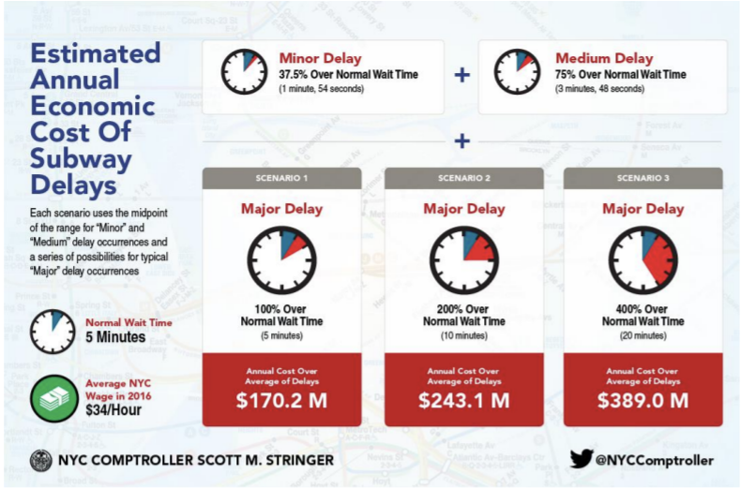

Why Ridr?
"I'm tired of standing at the station in the cold and see my train is late. I could be at home sleeping" - Jonathon Sun
Notes:
Focus on what the product would be for the stakeholder.

Slide 3
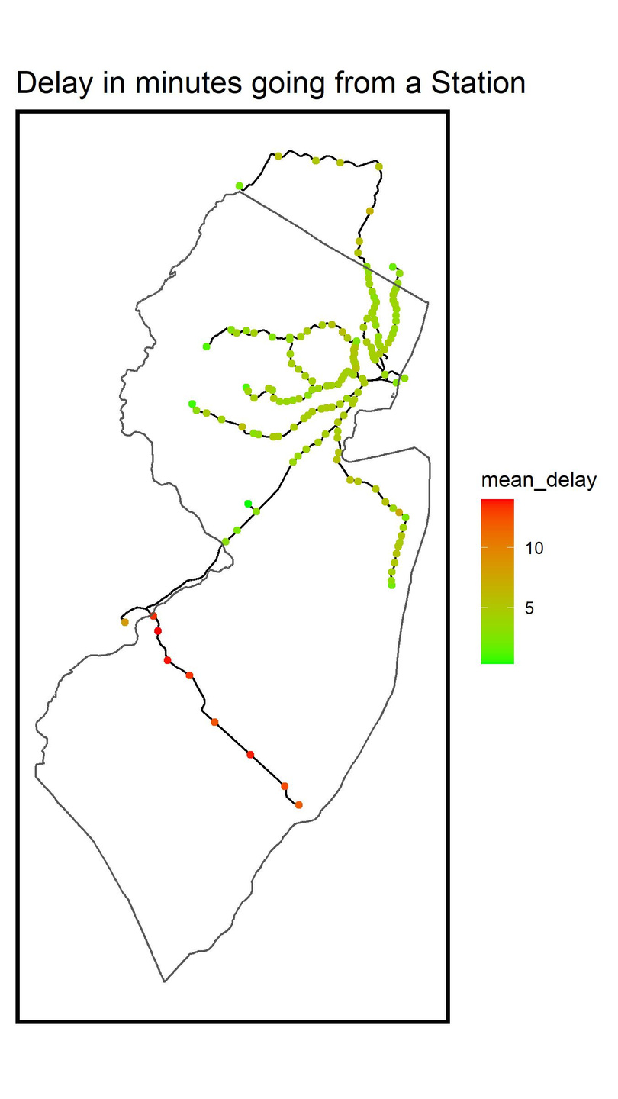
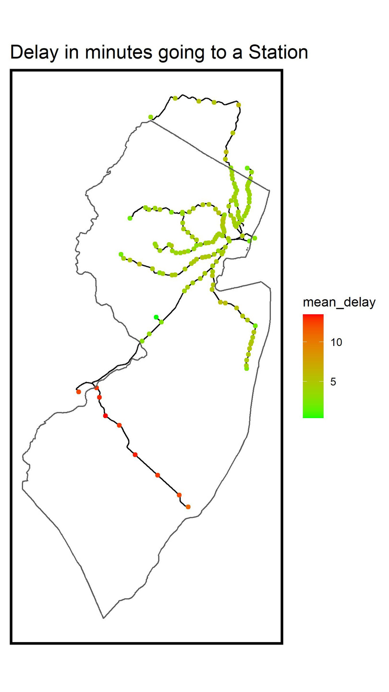
What we Know
By Geography
Notes:
Here's what we know
How you can apply this information to fixing delay times
There is a relationship between delays and geography. For example
The trolley line in south jersey in comparison to the train lines in north Jersey

Slide 4
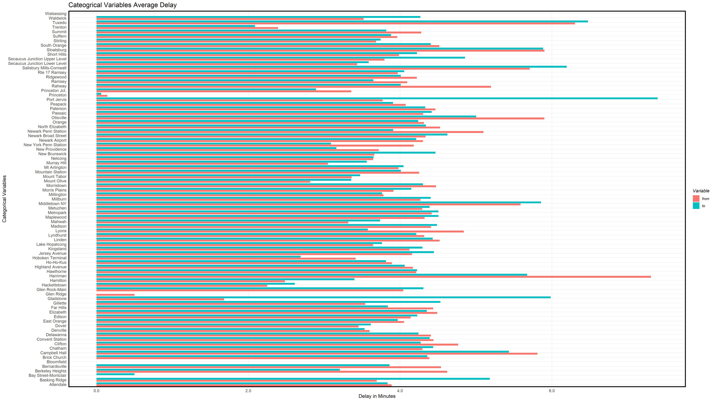
What we Know
By Station
Notes:
Separate the geography from the Stations. What stations are late independent.
Here we've identified stations that are experiencing chronic delays.
This will be an interactive figure, where we can have stake holders hone in on stations.

Slide 5
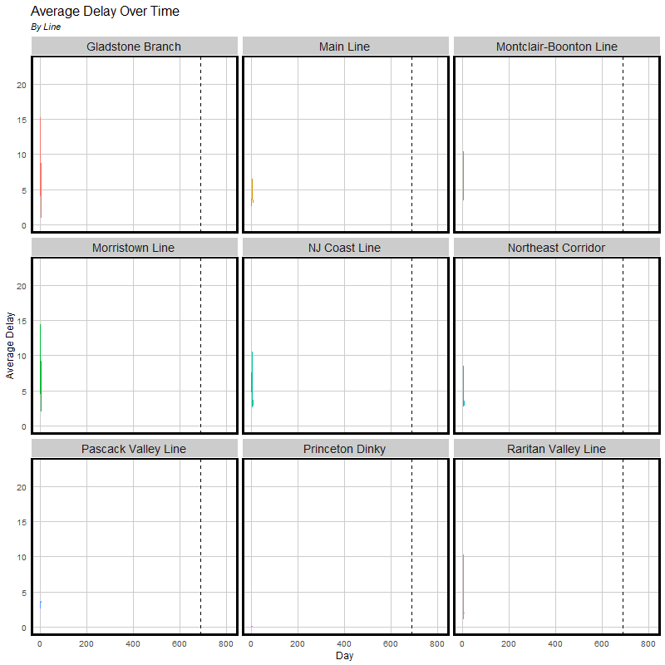
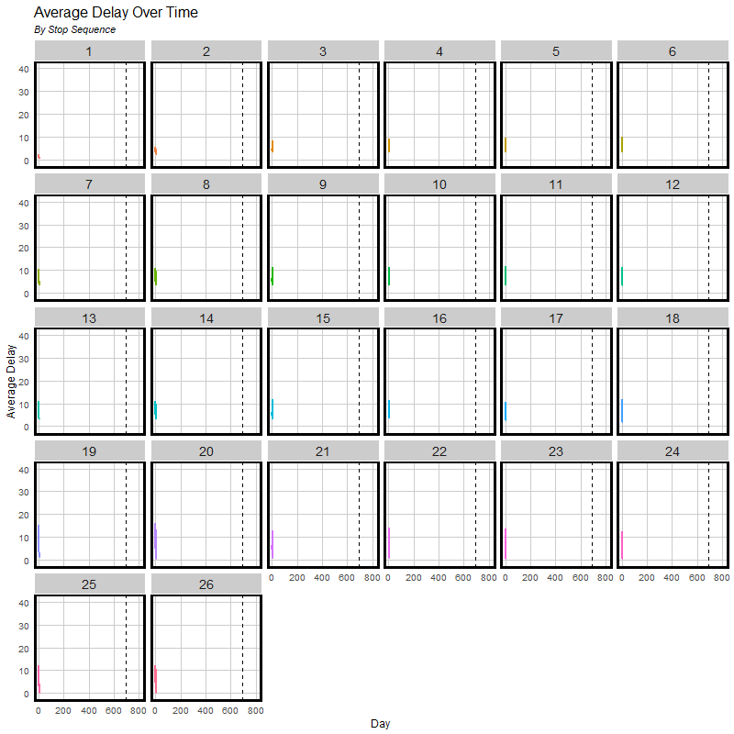
What we Know
Over time

Slide 6
Solution
Root Mean Squared Error
0.000…
1
Create a linear model to predict delay times.
Mean Average Error
0.000…
2
Model accounts for delays at origin and destination stations
R Squared
1
3
Cross-Validate estimated delay-times to ensure model predicts well
Notes:
Make sure that you mention how much error is in the model

Slide 7
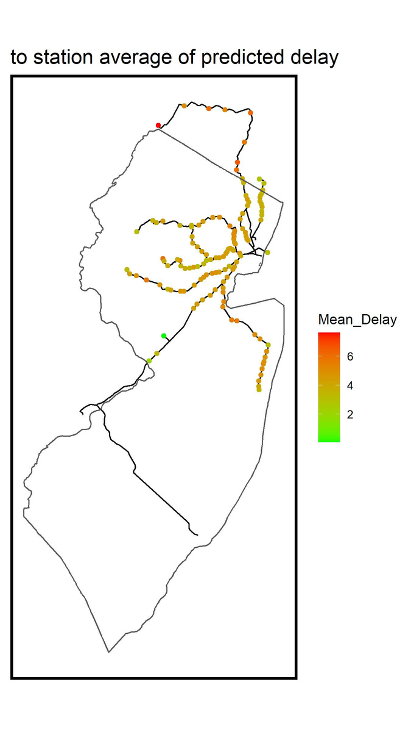
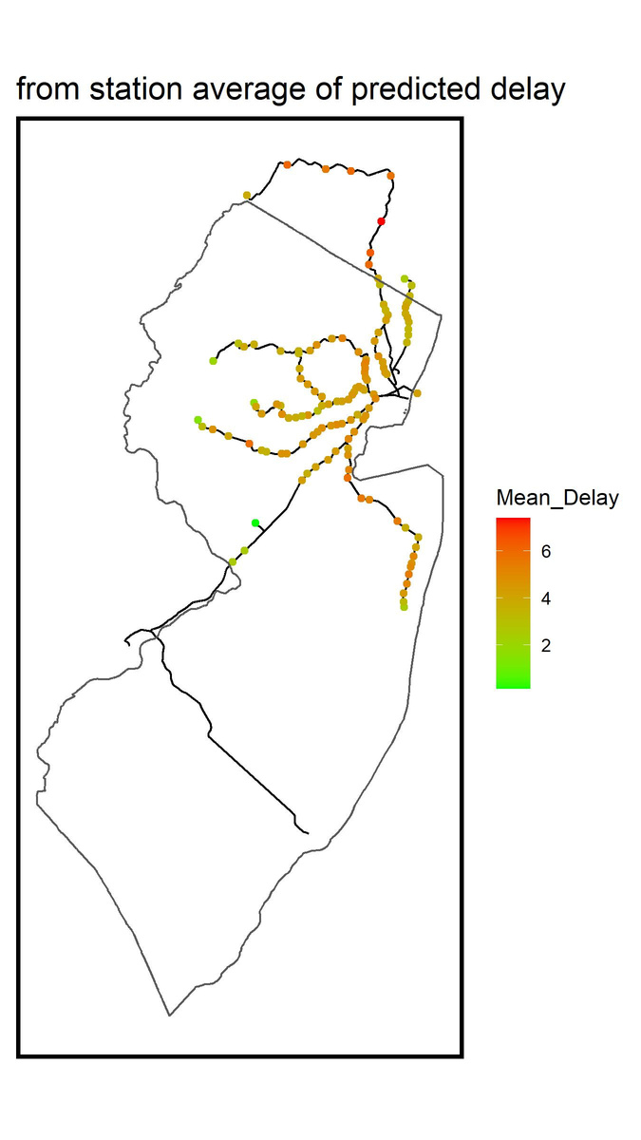
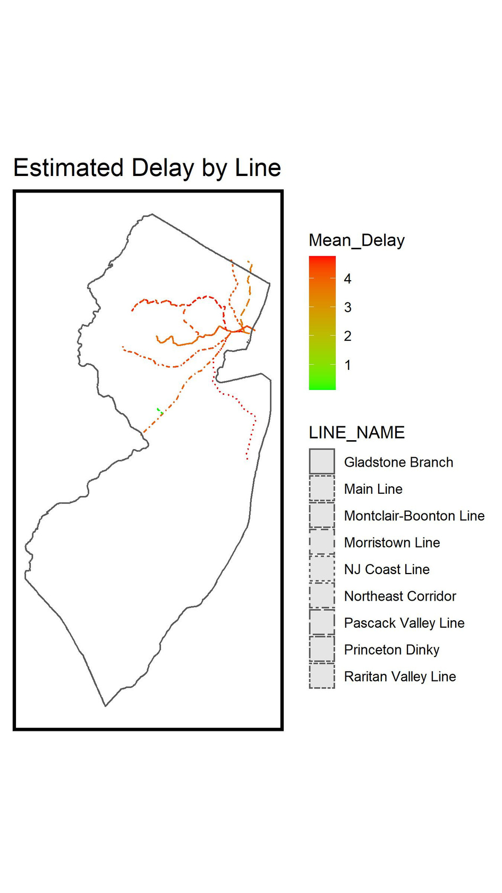

Model Weaknesses
Error by Geography
Notes:
Frame the model in how well the model predicts.
Make it more abstract, we have determined that the model has some percentage of predictive power.
Our model accurately predicts time.
FOr the staticians we have an Mean Average Error of 0.00000000.

Slide 8
Who is it for?
Agencies, Academics, and People
We believe in the power of the community to make change. Whether that be your everyday rider, a researcher, or an agency.
Agencies
Riders
Research
Mobile application
Desktop Application
Real-time train tracking
Detailed Dashboard of Train delays
Mobile application
Real time train tracking
Notifications
City and Regional Planners
Academics

Slide 9

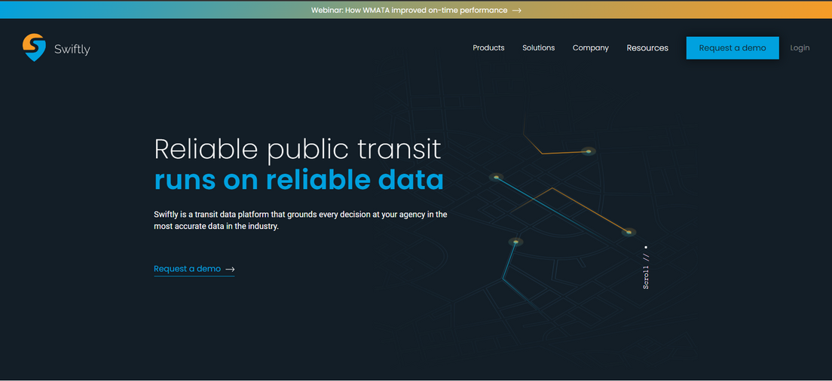

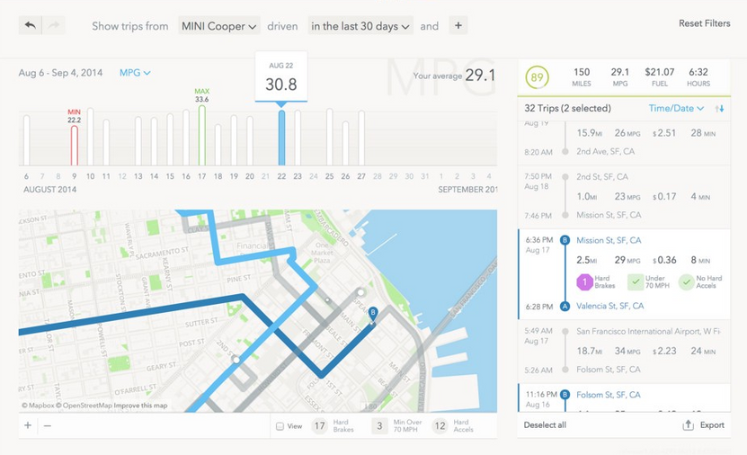
How it Works: Agencies and Researchers
Desktop Version
Notes:
Use this slide to show what the dashboard could look like

Slide 10
How it Works: Riders
Mobile application
Schedules
Real time updates
Predicted delays
Ridr

Slide 11
Future Products
Predict how much delay would turn someone away from taking transit
Regional Household travel survey
NJ transit probably has this data

Slide 12





Ridr
Jonathon Sun
Chief Modeling Officer
Meet the Team
Johnathan Clementi
Chief Visualization Officer
123-456-7890
info@ridr.com
ridr.com

